Slide 1


Welcome to Ryton-on-Dunsmore CE Academy
Wilde– Year 3/4
Let your light shine

Slide 2

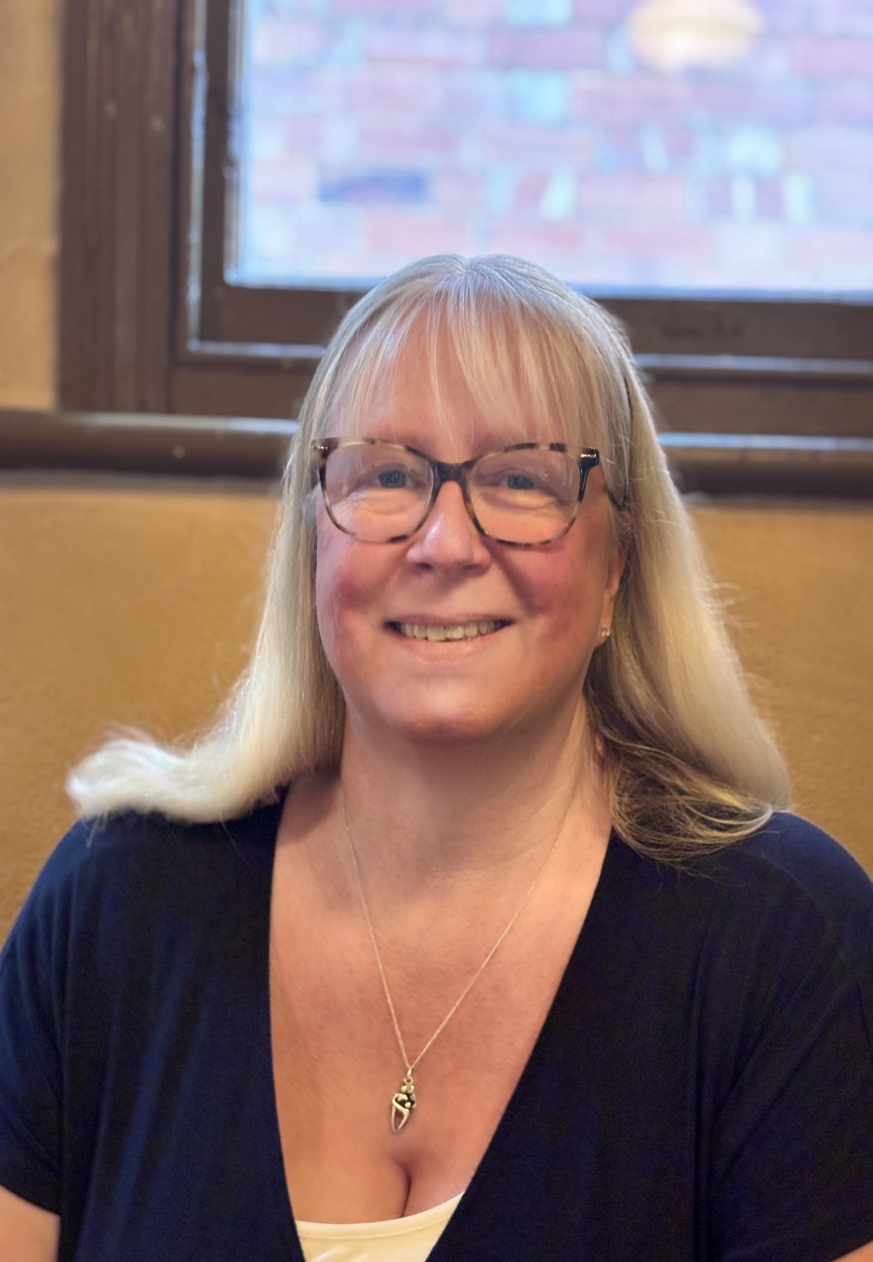
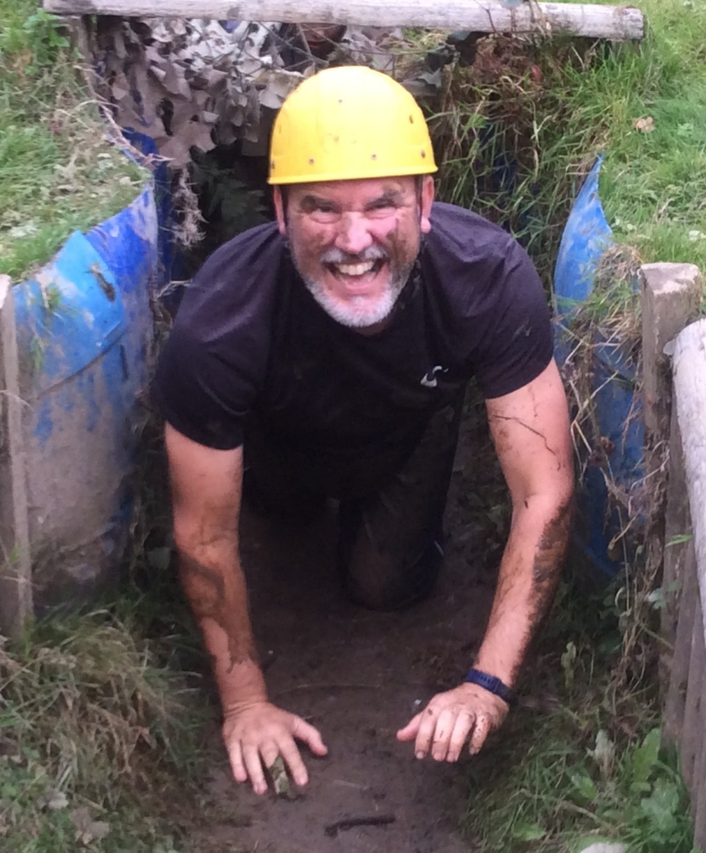
Class teachers
Mr. Lee

Slide 3
All about Mr Lee
I love challenging the children and myself, whether it’s a maths problem or a sporting event. I have a large family and love to take camping holidays all over the place. My pupils always groan at my jokes but work hard with enthusiasm in the classroom.

Slide 4
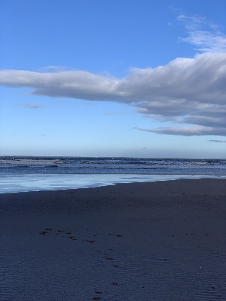


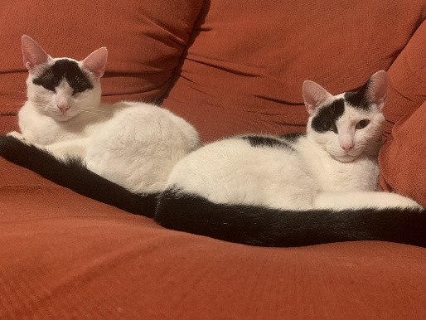
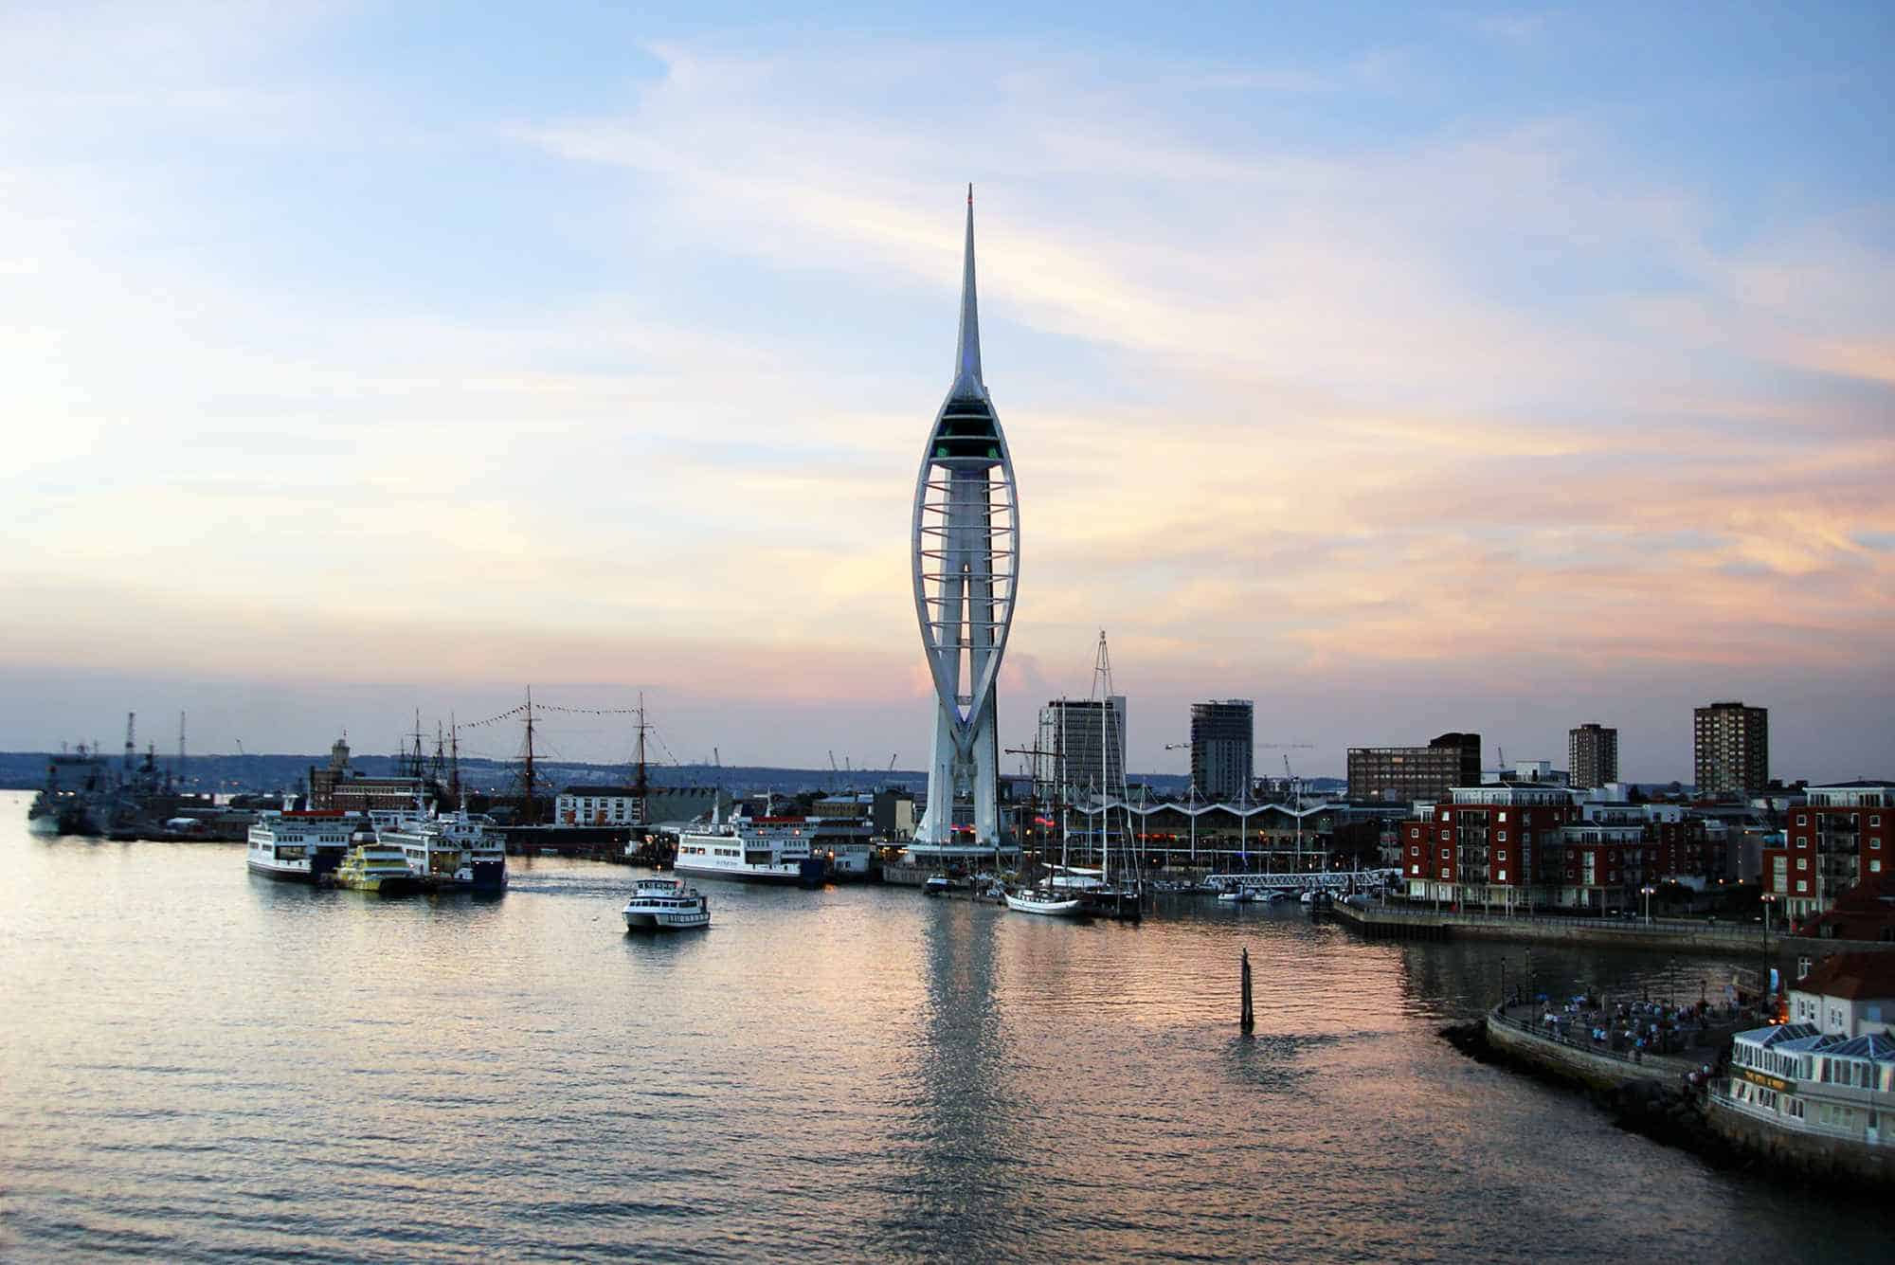

I grew up in Portsmouth, Hampshire but my family now live in Warwickshire.
I love reading, watching Rugby, going to musicals, walks in the countryside and along the beach.
I have a daughter who loves to dance and two cats, Patch and Puddles.
All about Mrs Lambeth

Slide 5
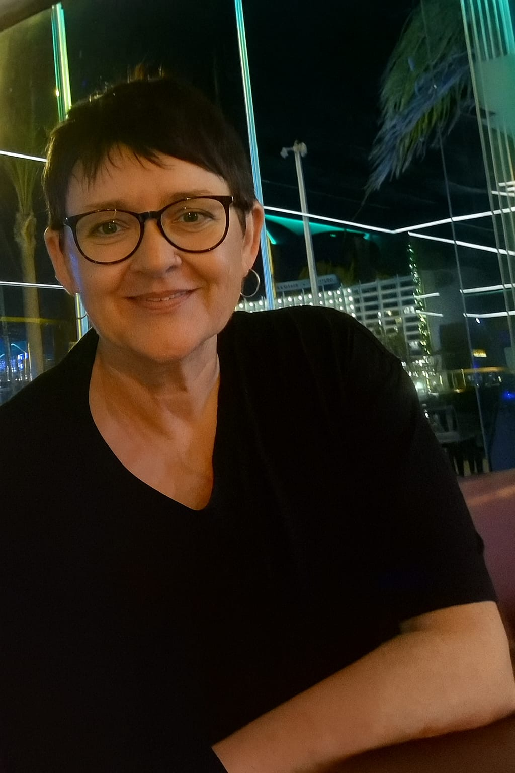
Support Staff
Mrs. Farrell

Slide 6

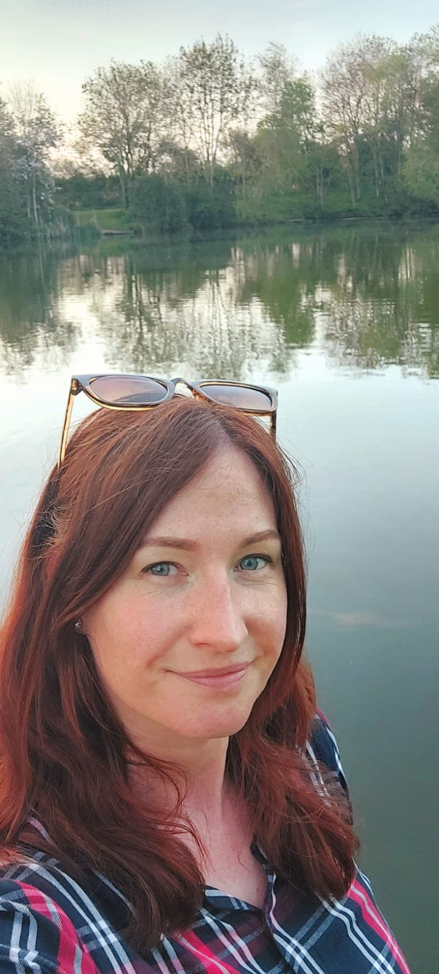
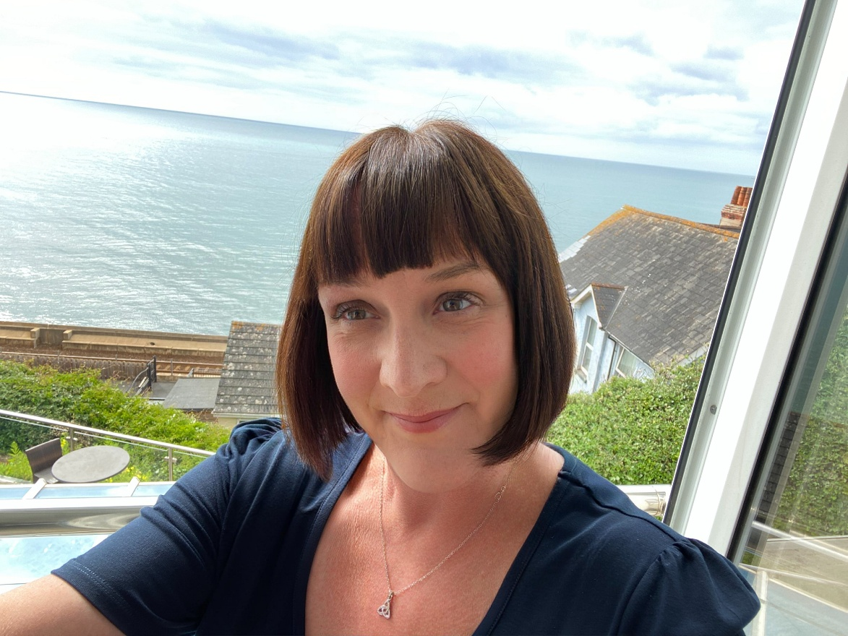
Support staff
Mrs. Firth
Miss. Ramsey

Slide 7
PE Days:
Swimming – Thursday
P.E. lesson - Friday

Slide 8
Topics to start the year:
Geography – the work of a cartographer, maps, symbols and grid references.
Science – The human body – muscles, skeleton, teeth, digestive system.

Slide 9
R.E. - Creation/Fall - What do Christians learn from the creation story?

Slide 10

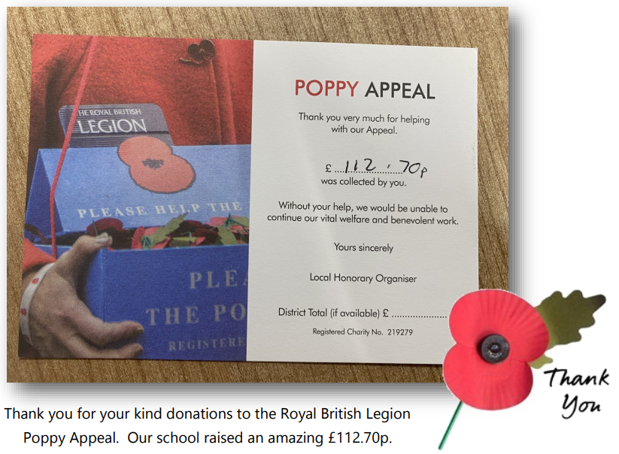

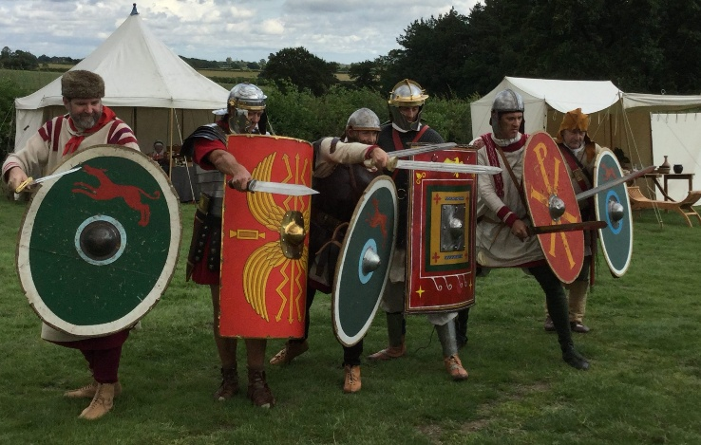


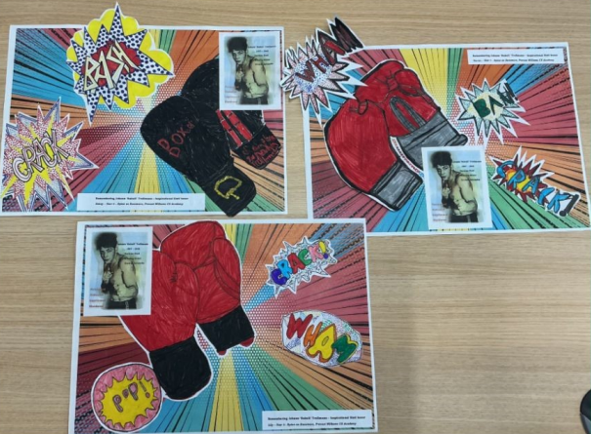
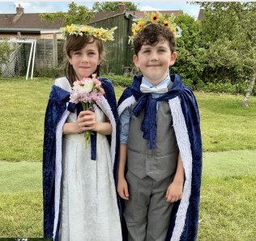
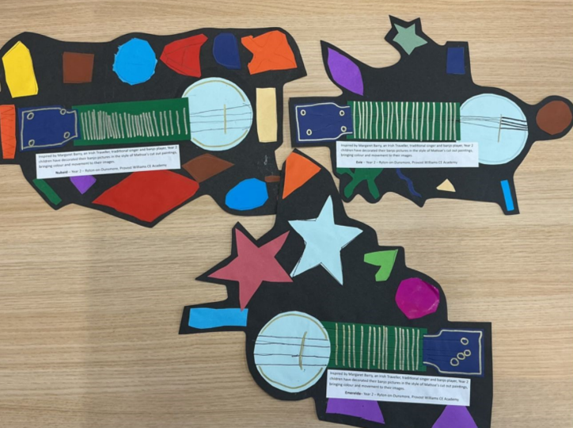
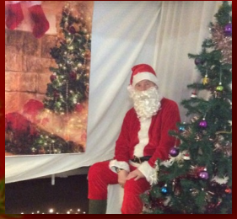

What to look forward to in our class
School trips
Sports opportunities
Supporting charities and the community
Art projects
Great stories
Celebrations

