Slide 1

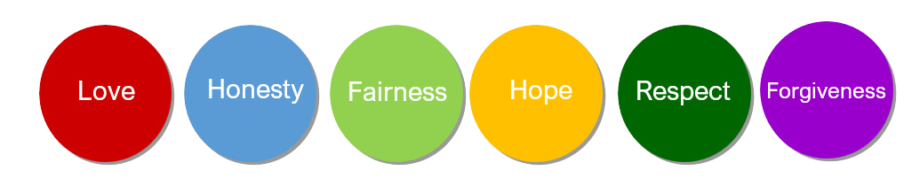
Welcome to Ryton-on-Dunsmore CE Academy
Rowling Class
Years 5 and 6
Let your light shine

Slide 2

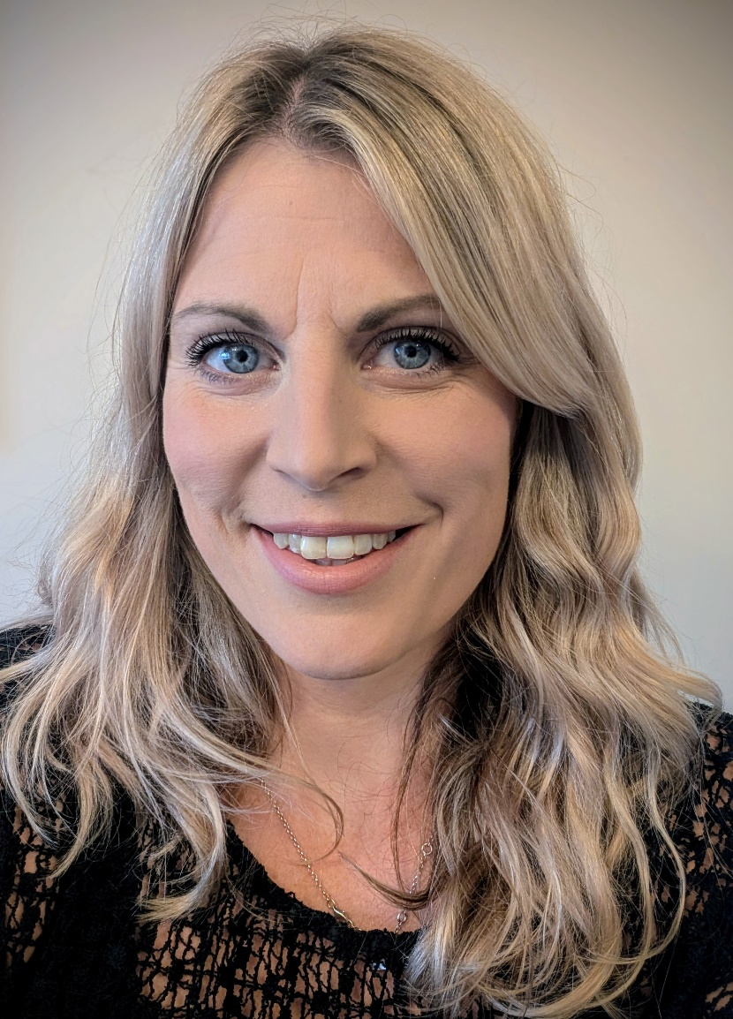

Year 6 staff
Miss Bright
Mrs Gayler

Slide 3
All about us – Mrs Gayler
Mrs Gayler has taught Year 6 for quite a few years now and particularly loves History, Music, Art and reading. Seeing children discover new books and authors they love is always a highlight of the job, as is seeing children in Upper KS2 grow in independence and get ready for the next adventure of secondary school!

Slide 4
All about us – Miss Bright
Miss Bright has taught Year 5 and 6 for the last 11 years!
She particularly enjoys teaching maths and science and building children’s confidence in all subjects, so that they enjoy their time at school.
When Miss Bright is not busy with her own 5 children, she can often be found curled up with a book or out running in the countryside.

Slide 5
All about our Year
At the beginning of the year we have our residential outdoor adventure week which remains a highlight of the year!
Rowling class take on lots of responsibilities around school and also take the lead in the KS2 Summer production. They act as buddies to our EYFS children as well as helping with events such as the Reading cafes. In the spring term there are before and after school booster sessions to prepare Year 6 for SATs, but they all look forward to the breakfasts in SATs week as well as the party afterwards and the end of year trips.

Slide 6


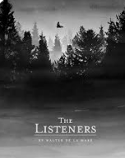
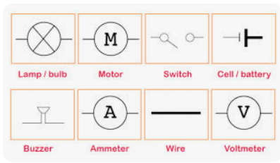
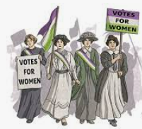
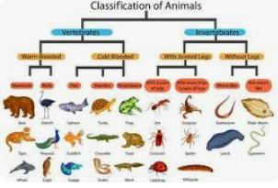
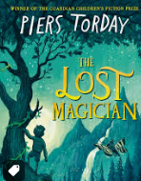
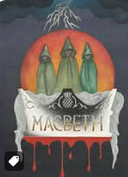
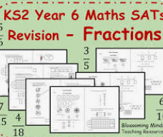

What to look forward to in our class
Frontiers- the residential is a great start to the Year
and you will really develop independence and perseverance!

